Slide 1
Viruses and Disease

Slide 2
Learning Goals
By the end of this lesson, I will be able to:
  Compare and contrast the structure and function of different types of viruses
  Understand how disease spreads and what makes them so virulent

Slide 3
Disease Transmission
What would happen if you interact with a person that has an infectious disease?
Grab a cup from the back benches and stand somewhere around the room.

Slide 4
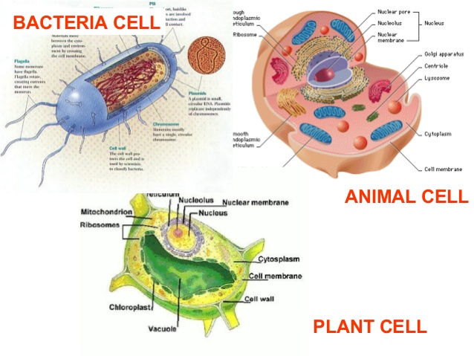
Structural Diversity
Differing external and internal structures
Plant cells vs. animal cells vs. bacterial cells

Slide 5
Prokaryotes vs. Eukaryotes
Characteristic | Prokaryotes: Bacteria, Archaea | Eukaryotes: Protists, Plants, Fungi, Animals
Cell Size | 1-10μm | 100-1000μm
Genetic material | Circular DNA, not membrane-bound Genome made up of a single chromosome | DNA in membrane-bound nucleus Genome made up of several chromosomes
Cell division | Not by mitosis and meiosis | By mitosis and meiosis
Reproduction | Asexual is common | Sexual is common
# of Cells | Unicellular | Most multicellular
Organelles | Membrane-bound organelles (like mitochondria) absent | Membrane-bound organelles (like mitochondria) present
Metabolism | Many are anaerobic | Most are aerobic
Notes:
Anaerobic = do not require oxygen to carry out cellular respiration, aerobic is opposite
Go to previous slide to show examples
SHOW VIRUS RAP VIDEO (https://www.youtube.com/watch?v=kYf_Sl8W3qY) BEFORE GOING TO NEXT SLIDE

Slide 6
Viruses
Different from both prokaryotic and eukaryotic cells
  Cannot live independently outside of cells; they invade cells and use the host cells for survival and reproduction
  Viruses are not cellular so they don’t have cytoplasm, membrane-bound organelles, or cell membranes
We do not consider them living organisms
Cause disease in plants and animals
Notes:
Outside of the cell viruses are dormant

Slide 7
Classifying Viruses
Not included in the classification of life, because they are not living
However, they do have genetic material and reproduce so we need a system to classify them
Classified based on size and shape of capsid (protein layer that surrounds genetic material)
Also grouped by the type of disease they cause
Notes:
Genetic material can be DNA or RNA

Slide 8
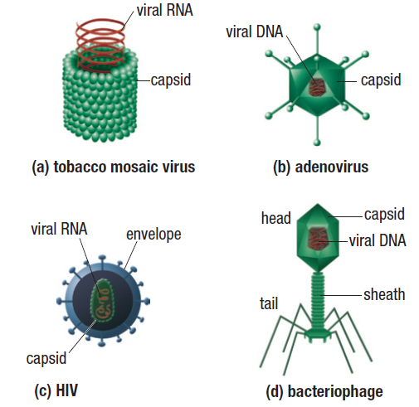
Different Classes of Viruses
Notes:
There are currently 21 groups of viruses that infect humans

Slide 9
Reproduction in Viruses
Reproduce by replication within a host cell, not cell division
Can undergo either lytic cycle or the lysogenic cycle
During the lysogenic cycle viral DNA becomes part of the host cell’s DNA
  This DNA is then called a provirus
  A provirus can invade a cell but not kill it
Notes:
Remember they are not cellular so cannot undergo cell division
Host cell can be eukaryotic or prokaryotic

Slide 10
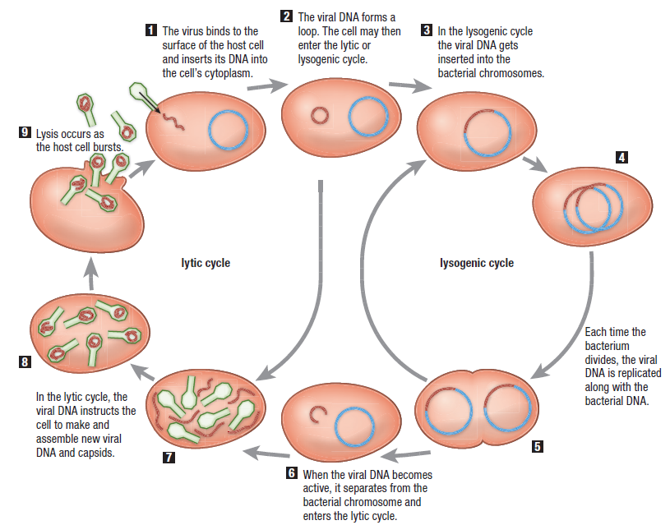
Notes:
Lytic Cycle Video: https://www.youtube.com/watch?v=wVkCyU5aeeU
Lysogenic cycle video: https://www.youtube.com/watch?v=_J9-xKitsd0

Slide 11
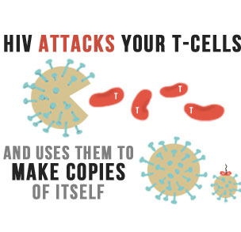
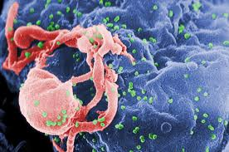
Viruses and Disease
Lytic cycle: new viruses burst from host cell and infect neighbouring cells (in multicellular organisms)
Lysogenic cycle: effects may not be immediate
  Ex. HIV/AIDS
Notes:
HIV (human immunodeficiency virus) is a retrovirus. Contains enzyme called reverse transcriptase which causes the host cell to copy viral RNA into DNA. After that the viral DNA enters host DNA and becomes provirus. Not all the cells that originate from this cells have the virus and can continue with no effects for years. At any time the provirus can separate from the host and complete more damaging lytic cycle. This is when it becomes AIDS.
HIV/AIDS Video**

Slide 12
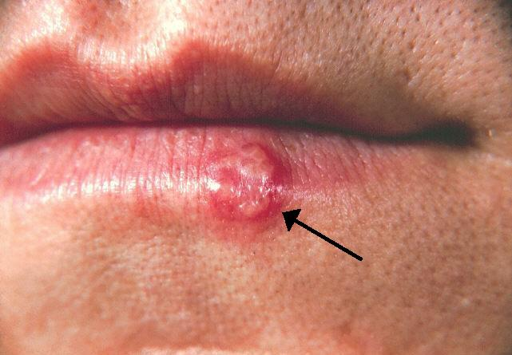
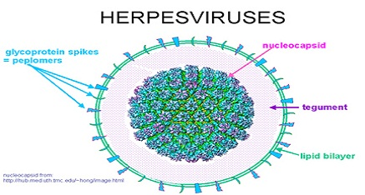
Patterns of Disease: Herpes Simplex Virus
Herpes Simplex Virus = Cold Sores
Sores appear and disappear throughout the lifetime of an infected person
What cycle do you think the virus is undergoing when the sores are present? Absent?

Slide 13
Prions
Non-viral Disease-causing Agents
Several types of brain diseases that mimic the pattern of viral infection but the infection agents stays infectious even after exposure to radiation.
  Radiation destroys DNA and RNA
In the 1980s Stanley Prusiner discovered that it was a new disease causing agent, a prion
Prions are proteins that are normally found in the body
Only known disease-causing agent without genetic material
Notes:
Cause mad cow
Mad cow/prions video**

