Slide 1
Identifying, Naming, and Classifying

Slide 2
Diversity of Living Things
Unit 1
BIG IDEAS
All living things can be classified according to their anatomical and physiological characteristics

Slide 3
Overall Expectations
In this Unit you will..
Analyze the effects of various human activities on the diversity of living things
Investigate through laboratory and / or field activities, or through simulation, the principles of scientific classification, using appropriate sampling and classification techniques.
Demonstrate an understanding of the diversity of living organisms in terms of the principles of taxonomy and phylogeny.

Slide 4
Unit 1 Contents
Chapter 1
Classifying Life’s Diversity
How do scientists classify life on earth?

Slide 5
Specific Expectations
In this chapter you will learn how to …..
B1.1 analyze some of the risks and benefits of human intervention to the biodiversity of aquatic and terrestrial
ecosystems (1.4)
B2.1 Use appropriate terminology related to biodiversity (1.1,1.4)
B2.4 Create and apply a dichotomous key to identify and classify organisms from each of the kingdoms (1.3)

Slide 6
Specific Expectations
B3.1 Explain the fundamental principles of taxonomy and phylogeny (1.1, 1.2)
B3.2 Compare and contrast the structure and function of different types of prokaryotes, eukaryotes, and viruses (1.3)
B3.5 Explain why biodiversity is important to maintain viable ecosystems.

Slide 7
Learning Goals
By the end of this lesson I will be able to:
  use appropriate terminology related to biodiversity, including, but not limited to: binomial nomenclature, taxonomy, phylogenetic trees, and morphology
  explain the fundamental principles of taxonomy and phylogeny by defining concepts of taxonomic rank and relationship, such as genus, species, and taxon

Slide 8
What is a Species?
On your own try to define “species”
Write down your definition in your notes
Notes:
Tell students not to use their text

Slide 9
What is a Species?
With your seat partner, share your definitions and alter them so that you have one final definition
Write down your new definition in your notes

Slide 10
What is a Species?
Share your definitions with the class.
What final definition can we come up with as a class?
Write down our class definition in your notes

Slide 11
What is a Species?
A species is generally defined as “a group of organisms that can interbreed in nature and produce fertile offspring”
How does this compare to our definition?
Do you see any problems with this definition?
Notes:
Over 2 million species have been identified. This seems like a lot but scientists estimate that the total number of species on earth is somewhere between 5 and 20 million. New species are discovered each day!
It is important to many people to know what species are. Farmers need to identify crops and weeds, doctors need to identify species of bacteria, border inspection needs to identify species to prevent the introduction of invasive species.

Slide 12
Identifying Species
Suppose you discovered a new species of fruit
  How do you determine how closely related they are to other species?
  How would you classify
  them and give them
  their scientific names?
Notes:
Do a directed brainstorm in class using small pieces of paper or sticky notes. Give each student four or five slips of paper, and ask them to write the name of one living thing on each piece. Then, have groups of four students combine their slips and sort the living things by characteristics (e.g., can fly, covered with fur, etc.). Once students have created their groups, ask them to label each group (e.g., birds, pets). As a class, discuss how they decide on their groupings. This introduces the idea of classification and taxonomy and acts as a diagnostic of student background knowledge of living things.

Slide 13
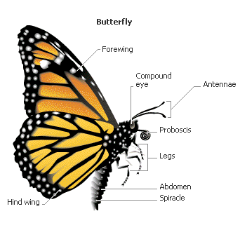
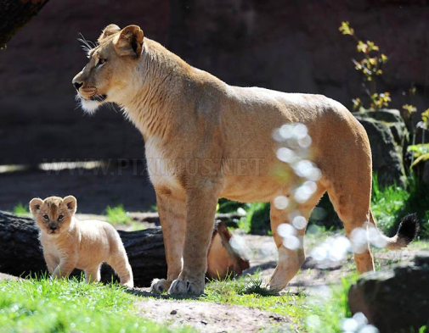
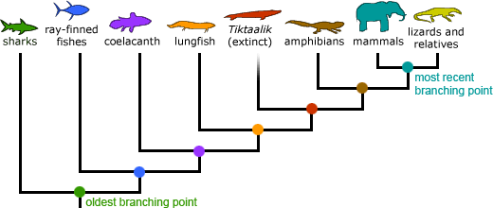
Identifying Species
Instead of having only one definition of a species, we have different species concepts to try and aid with classification
  Morphological Species Concept
  Biological Species Concept
  Phylogenetic Species Concept
Notes:
Not having a solid definition of a species makes identifying and classifying species very difficult!

Slide 14

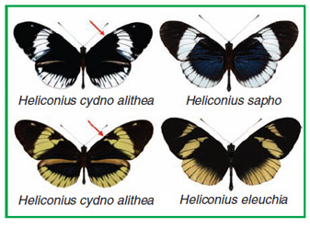
Morphological Species Concept
Focus on body shape, size, and structure
Most widely used, especially in plants
Notes:
Scientists will compare measurements and observations of two different organisms and debate whether or not the organisms represent different species.
This species concept is relatively simple. Challenge: not all individuals in a species are identical, the challenge comes with decide how much change is too much change

Slide 15
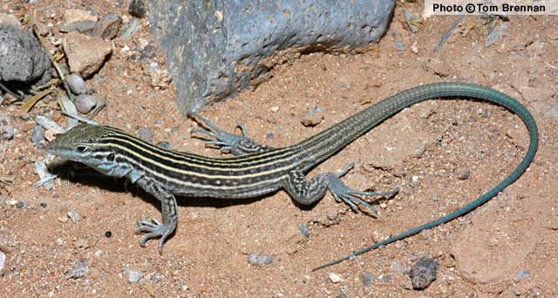
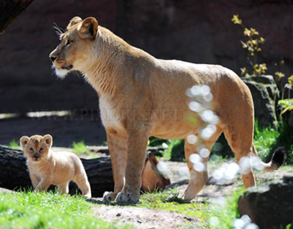
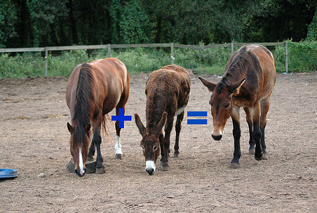
Biological Species Concept
Focus on whether two organisms can produce fertile offspring
Widely used by scientists
Notes:
This is like our general definition from our text. Challenges: if two populations are separated physically (ex by mountain range or ocean) they have never had the chance to naturally interbreed. Also some species reproduce asexually. It can also not be applied to fossil species that are no longer reproducing. The lizard shown is a New Mexico Whiptail that reproduces using parthenogenesis (all female population in which offspring develop from unfertilized eggs).

Slide 16
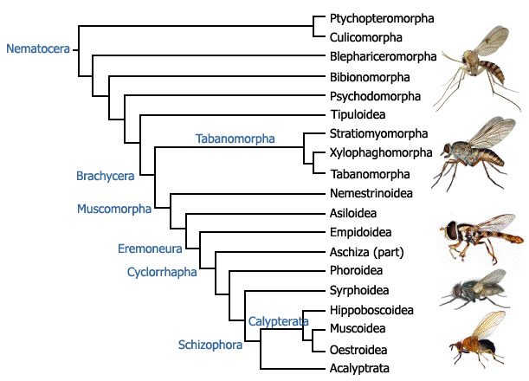

Phylogenetic Species Concept
Focus on evolutionary history of organisms
Can be applied to extinct species
Uses DNA analysis
Notes:
Phylogeny means evolutionary history. They define a species as a cluster of organisms that is distinct from other clusters and shows a pattern of relationship.
Challenge: Evolutionary histories are not known for all species

Slide 17
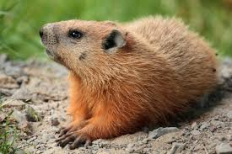
Naming Species
Notes:
We have many common names for this animal (groundhog, woodchuck, whistle pig, forest marmot) but we only have scientific name for is (Marmota monax)

Slide 18
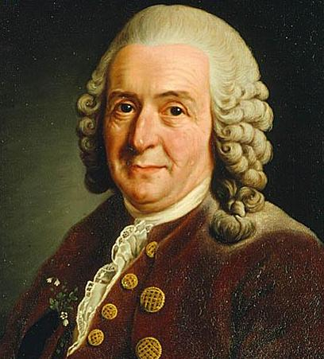
Taxonomy
The branch of biology that identifies, names, and classifies species based on natural features
Carl Linnaeus: the father of taxonomy
  Grouped organisms based
  on physical characteristics
  Established the naming
  system we use today
Notes:
Linnaeus is a Swedish nautralist. Mendel was the father of genetics, Linnaeus is the father of taxonomy
https://www.youtube.com/watch?v=Gb_IO-SzLgk (4 mins)

Slide 19
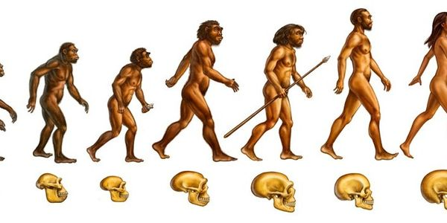
Naming Species
Carl Linnaeus established the system we use for naming, binomial nomenclature
We give each species a two part Latin name consisting of its genus and species
  Ex. Homo sapiens (H. sapiens)
Notes:
We capitalize the genus but not the species and we put it in italics. Binomial means two parts and nomenclature means naming something. If we are handwriting something we can’t do italics so we underline both parts of the name.

Slide 20
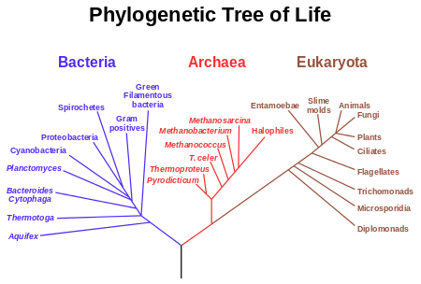
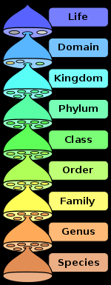
Taxonomy
Notes:
Each level is called a rank, each group of organisms is called a taxon (plural taxa)
There used to be only two Domains, Eukarya and Prokarya. Eukaryotes Of the five kingdoms Eukarya has 4 (animalia, protista, plantae, and fungi) and prokarya had monaea (bacteria and archaea now). They later found that some organisms looked like bacteria but weren’t bacteria. We now call this domain archaea. There are 6 kingdoms now, monaea is gone and we have eubacteria and archaea in their place.

Slide 21
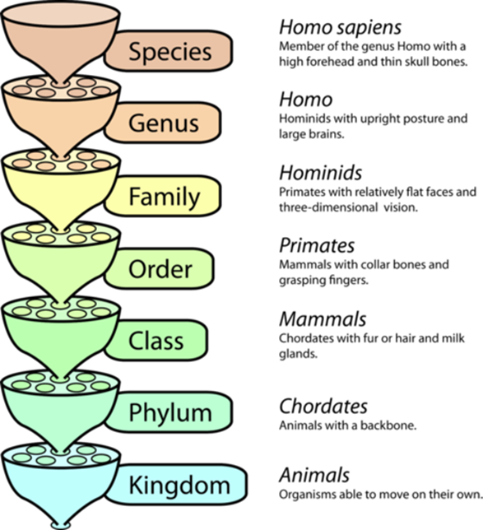
Let’s Classify Humans
Domain: Eukarya
Kingdom: Animalia
Phylum: Chordata
Class: Mammalia
Order: Primate
Family: Hominidae
Genus: Homo
Species: Sapiens

Slide 22
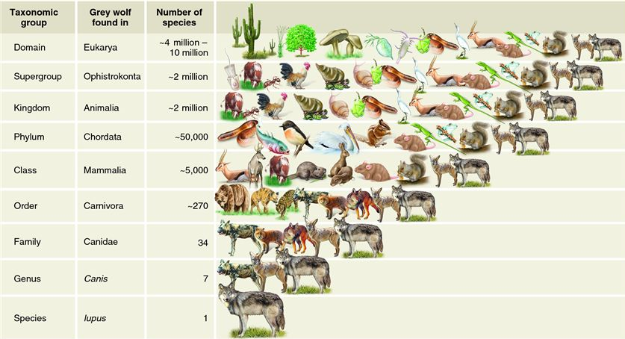
Classification of Wolves
Notes:
Eukarya: multi-celled organisms with a nucleus
Animalia: capable of movement on their own
Chordata: backbone
Mammalia: warm-blooded, fur or hair, milk glands (nurse young)
Carnivora: adapted for meat-eating
Canidae: the dogs (five toes on front feet, four toes on back feet, can’t retract claws, elongated snouts)
Canis: grey wolves, coyotes, etc.

Slide 23
Species Relatedness

Slide 24
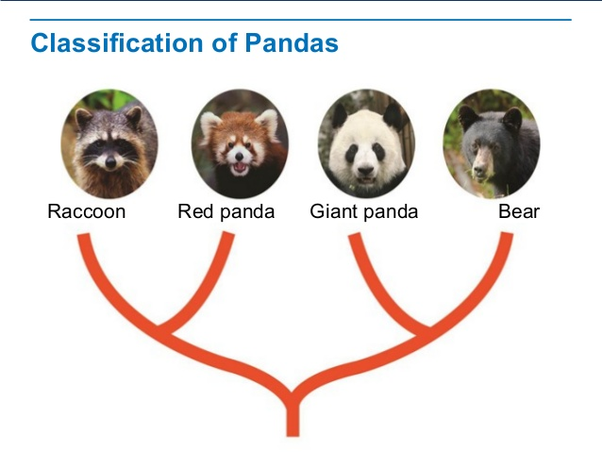
Relatedness
Notes:
Giant pandas have characteristics from both raccoons and bears. Which one is it more closely related to? Debated for over 100 years about how to classify them. Finally settled that they are more closely related to bears

Slide 25
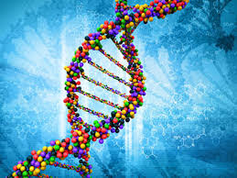
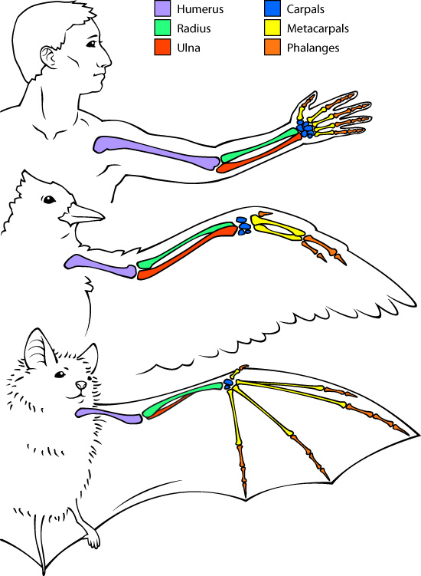
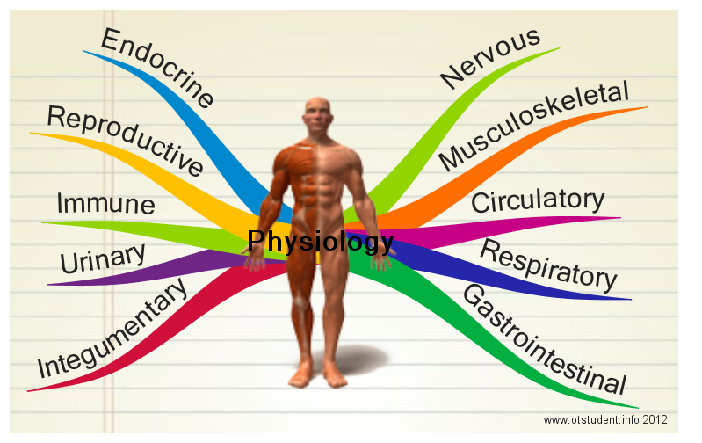
Relatedness
Scientists use three main types of evidence to determine evolutionary histories:
  Anatomical
  Physiological
  DNA

Slide 26

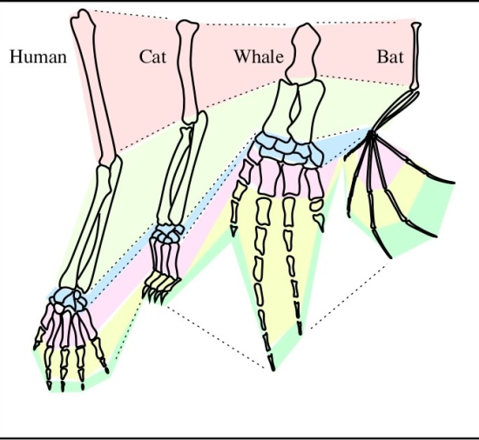
Anatomical Relationships
Anatomy deals with structure and form, including internal systems
Comparing the bones in the arms of animals helps to determine relatedness
Arrangement of each is the same

Slide 27
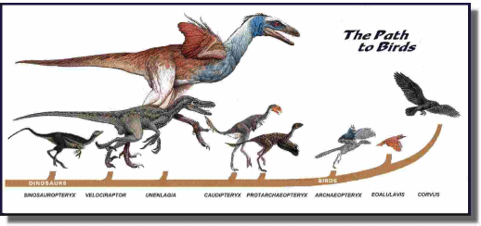
Anatomical Relationships
Notes:
A lot of people think that reptiles are the closest living relative to dinosaurs, scientists believed this for a long time too! Now they know that birds are actually more closely related to dinosaurs than reptiles are.

Slide 28
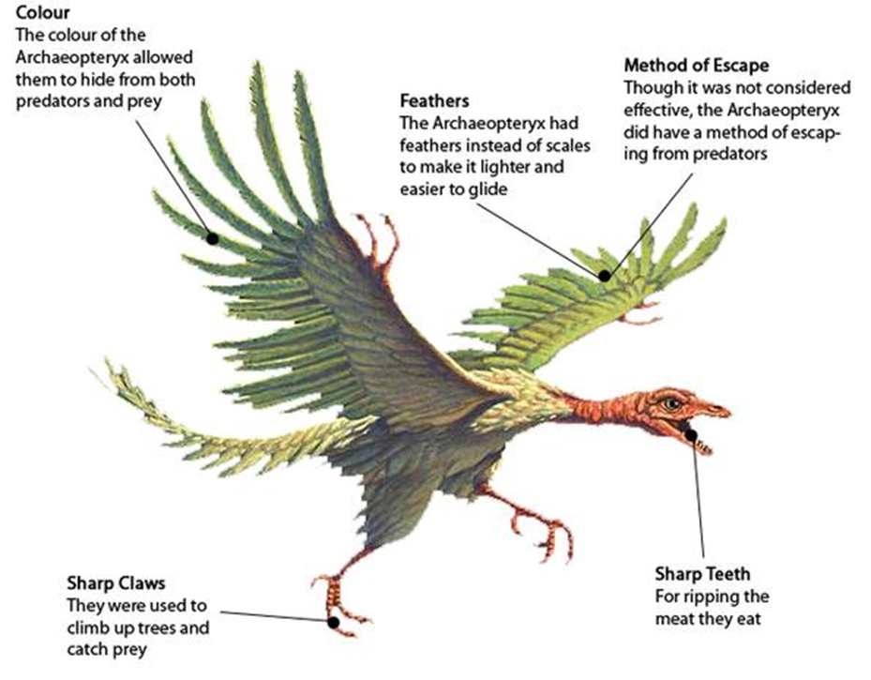
Anatomical Relationships
Notes:
Archaeopteryx is the middle of birds and dinosaurs. It has traits from each.

Slide 29
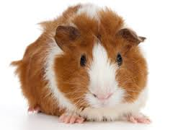
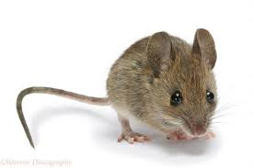
Physiological Relationships
Physiology deals with physical and chemical functions of organisms including internal processes
Genes code for proteins, studying the proteins a certain organism makes gives us an indication of the genes it has
Notes:
Guinea pigs and mice were both classified in the order Rodentia but more recent studies have shown that the insulin produced by guinea pigs is very different than that of mice and other rodents. They were then reclassified into an order of their own because their insulin was so different.

Slide 30
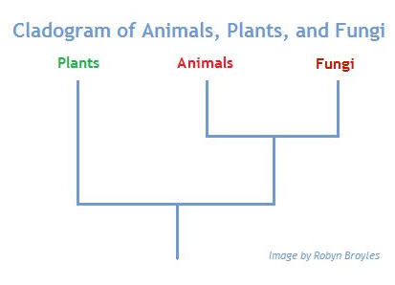
DNA Evidence of Relationships
Genetic analysis has shown us that fungi are actually more closely related to animals than plants
  Does this surprise you?
We have been able to
sequence the genome
of many animals and
compare them
This has allowed scientists to correct many classifications that were previously wrong

Slide 31
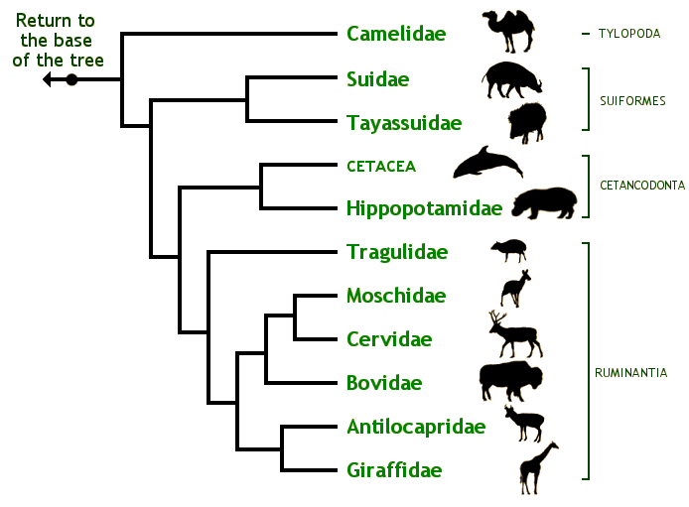
Phylogenetic Trees
A branching diagram used to show the evolutionary relationships among species
Notes:
Species that have evolved from a common ancestor have traits in common. We use these to define each family level on the tree. When new characteristics arise, another branch on the tree is made

Slide 32

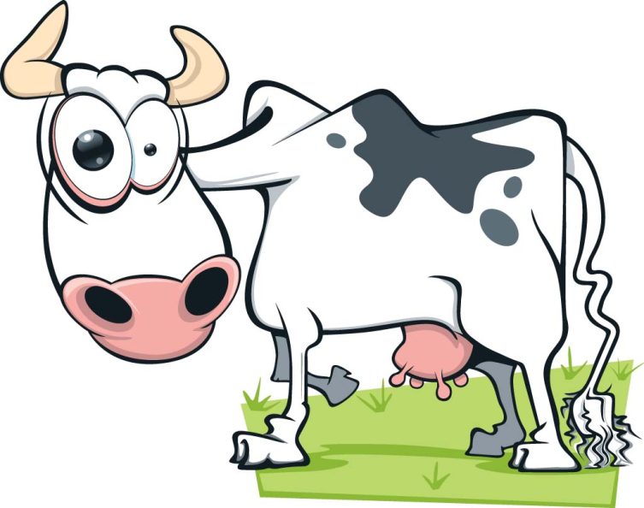
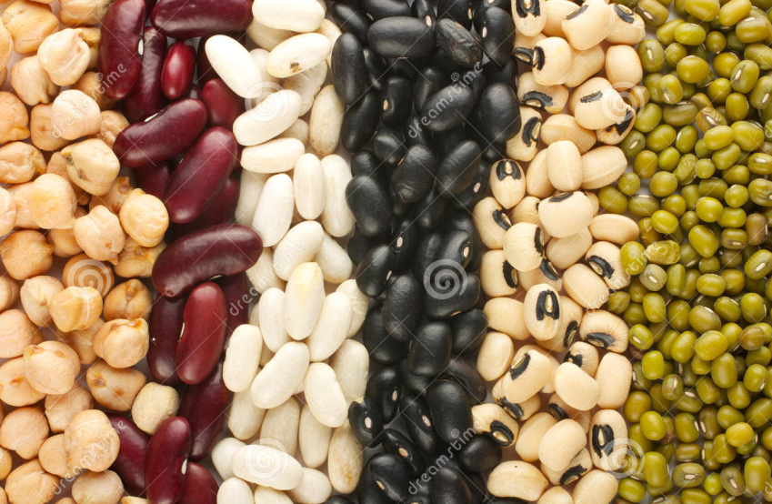
The Importance of Classification
Pharmacy
Studying Disease
Agriculture
Notes:
Pharmacy: When pharmacists are looking for medical products, they can look at closely related organisms that produce the protein or chemical
Transmission of Disease: Can trace transmission ex. from cows to humans
Agriculture: cross breeding close species to increase crop yields and disease resistance. Also need knowledge of predators
Show if extra time, video on taxonomy: https://www.youtube.com/watch?v=19Gz5CFLGKw (4.5 mins)

