Slide 1
The Respiratory System

Slide 2
Cellular Respiration
We need oxygen to survive! Our cells use oxygen as part of the process of obtaining energy from food.
  This is called aerobic cellular respiration
Glucose is the main molecule that we obtain energy from. The reaction between glucose and oxygen in cells is what produces energy.
  C₆H₁₂O₆ + 6O₂ → CO₂ + H₂O + energy
What would we use this energy for?
  Thermal Energy (64%)
  ATP – energy storage molecule, product of cellular respiration (36%)

Slide 3
Gas Exchange
Stages is respiration:
1) Breathing (inspiration and expiration) – moving air from outside the body to inside and the opposite
2) External respiration – exchange of oxygen and carbon dioxide between the inspired air inside the lungs and the blood (this stage performs the vital function of GAS EXCHANGE)
3) Internal respiration – exchange of oxygen and carbon dioxide between the blood and the body’s tissue cells
4) Cellular Respiration – the series of energy-releasing chemical reactions that take place within cells

Slide 4
Gas Exchange
The diffusing of oxygen into cells and carbon dioxide out of cells
2 main requirements for respiration:
  1) respiratory surface (the area in the animal’s body where gases are exchanged) must be large enough for exchange of gases to occur fast enough to meet the body’s needs
  2) respiration must take place in a moist environment

Slide 5
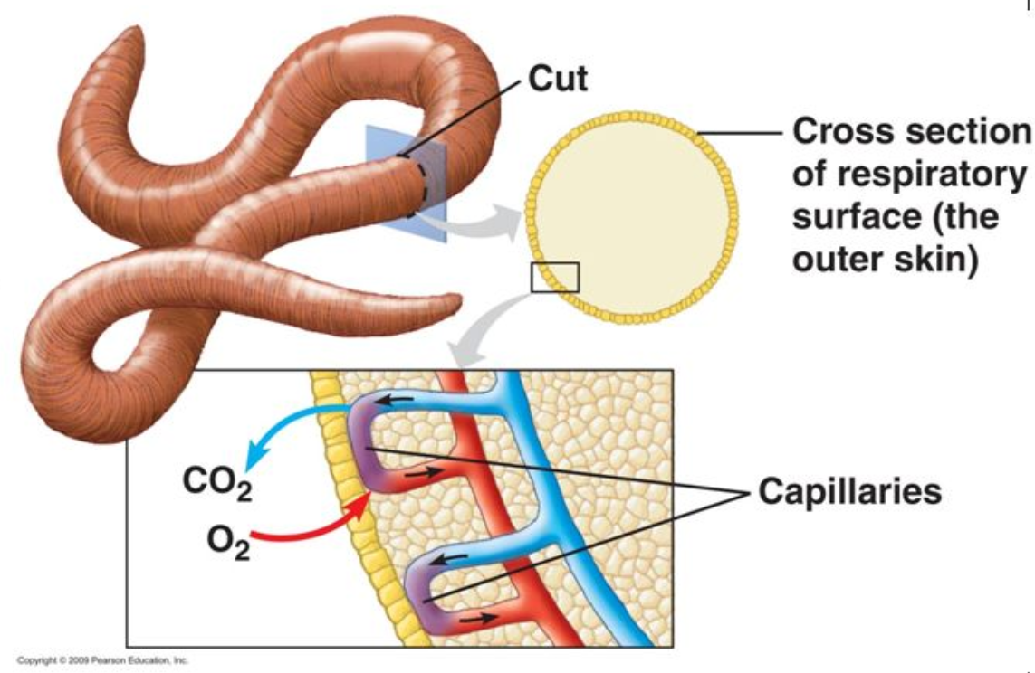
Types of Respiratory Systems
Outer Skin (sponges, jellyfish, worms, some amphibians)
  No specialized gas exchange organs
  Oxygen diffuses from surrounding environment into a network of thin-walled capillaries just below the skin, and carbon dioxide diffuses out.
  Live in damp places… why??
  High ratio of respiratory surface to body volume

Slide 6
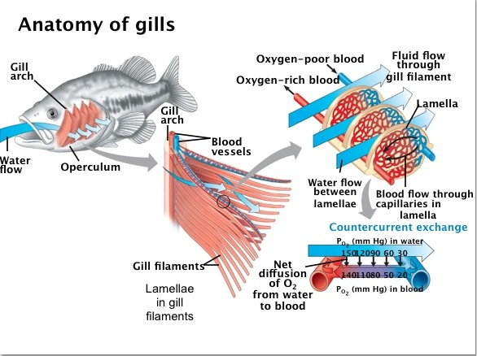
Types of Respiratory Systems
Gills (Fish)
  Gills are folded and branched structures to increase surface area for diffusion
  In bony fish, gills are located under bony flap on the side of the head. Mouth movement and bony flap help to move water over the gills
  Some fish, such as sharks, must be continuously moving to ensure water is flowing over the gills
  Countercurrent exchange – maximizes amount of oxygen diffusing into the blood

Slide 7
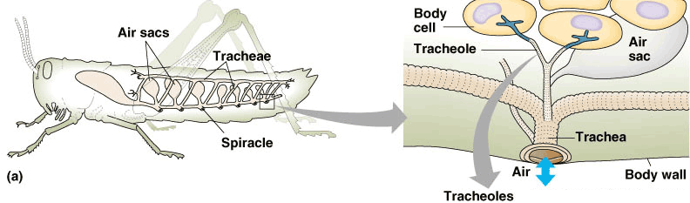
Types of Respiratory Systems
Tracheal (Insects)
  Internal system of branching respiratory tubes called tracheae
  Connect body cells to outside environment using even smaller tubes called spiracles
  Oxygen enters the spiracles and diffuses into the tracheae, CO₂ moves out the opposite way
  Circulatory system is not involved!

Slide 8
Types of Respiratory systems
Lungs (mammals, birds, reptiles, most amphibians)
  Two locations of gas exchange: the lungs and the body cells
  Oxygen diffuses into the blood in the lungs, is transported to body cells and diffuses out. CO₂ diffuses out of the cells into the blood and is transported to the lungs and diffuses into the lungs
Four important features…
  Thin, permeable membrane where diffusion can occur
  Large surface area for gas exchange
  Good supply of blood
  Breathing system for bringing oxygen-rich air to the respiratory membrane

Slide 9
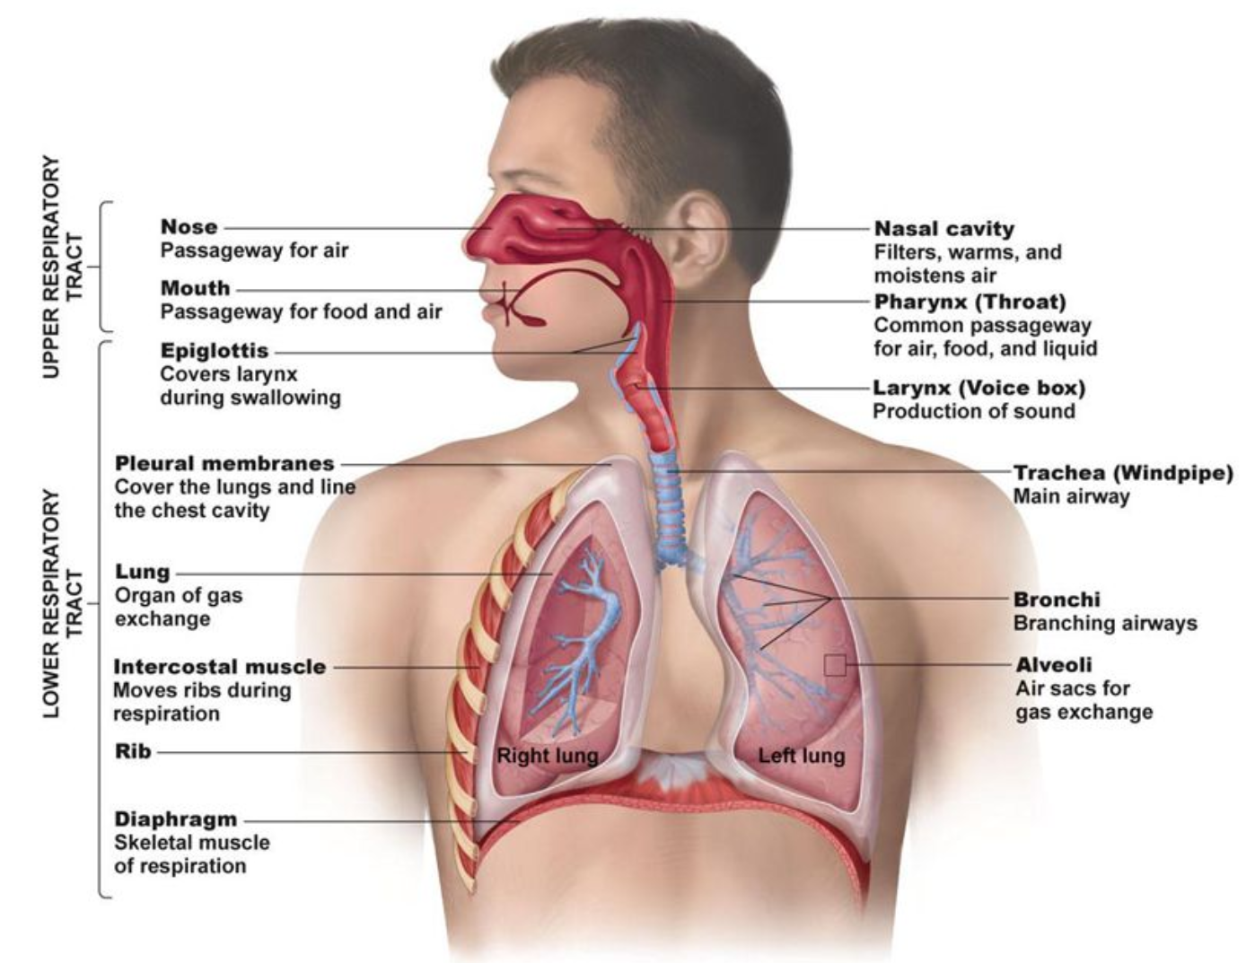
Human Respiratory system

Slide 10
Human Respiratory system
Air enters the nose and mouth, it is warmed and moistened and travels to the lungs
  Nasal passage is lined with mucus and hairs to trap foreign objects
Air continues through the glottis and down the trachea
  Trachea is also lined with cilia (little hairs) and mucus to trap foreign matter
Trachea leads to two bronchi (one in each lung) which branch into smaller bronchioles, capped with tiny sacs called alveoli
  Alveoli are very this (one cells thick) and surrounded by a network of capillaries for gas exchange

Slide 11
Homework Questions
Define key terms in 10.1/10.2
Read pgs 438-439, Q’s pg 439 #1-5
Reach pgs 440-441 and pgs 445-446, Q’s pg 446 # 1, 3, 4, 11

