Slide 1
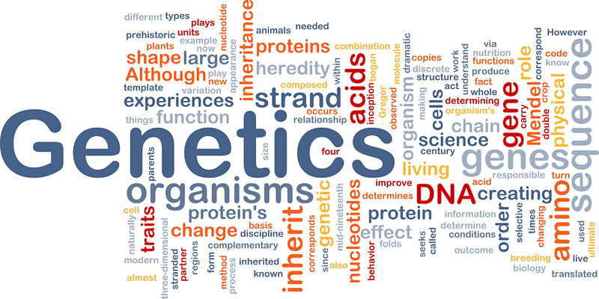
Genetics Review

Slide 2
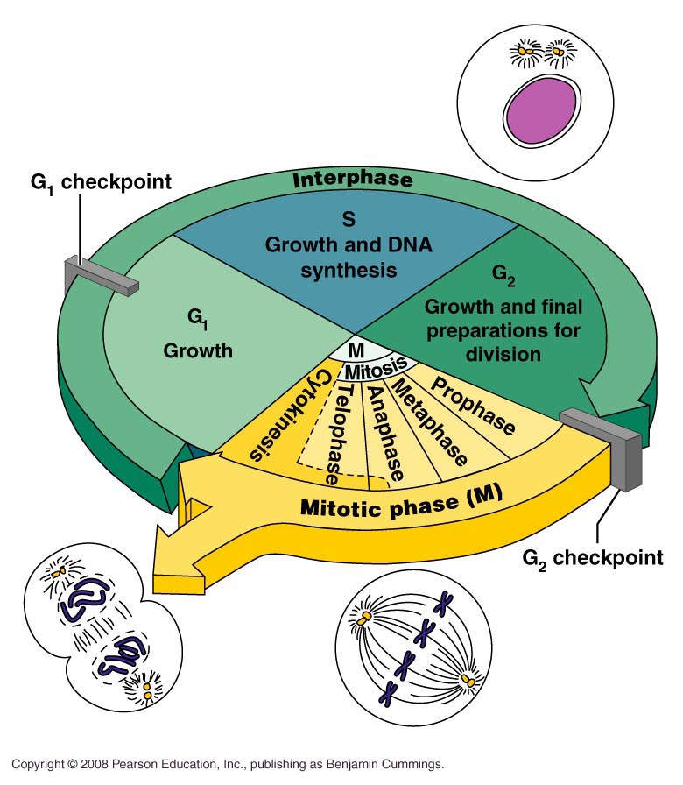
Life of a Cell
Divided into 4 phases
  G1 phase (Growth)
  S phase (Synthesis)
  G2 phase (Growth)
  M phase (Mitosis)

Slide 3
Cell Cycle
During the cell cycle the cell grows and prepares
its self for cell division
Primary goal of cycle is cell division
Though division main goal, cell spends most of its time preparing for division
Time spent preparing for
cell division the cell is in
the stage of interphase

Slide 4
Cell Cycle
Involves packing the genetic information into
2 equal portions
  Process is called mitosis
In division cytoplasm is split into 2 equal portions as well
Parent cell divides to make two daughter cells
Mitosis used for growth and repair

Slide 5
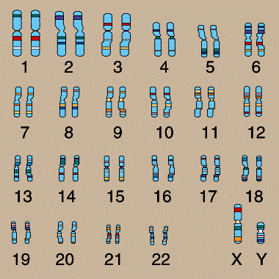
Chromosomes
Found in all cells
Are pieces of coiled DNA and proteins
Number of chromosomes in cells depends on the organism
  Humans have 46 chromosomes: 23 matching pairs.

Slide 6
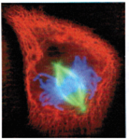
Chromosomes
Before division occurs each chromosome must be duplicated
Chromosomes have two identical copies
  called sister chromatids
Copies are held together
by centromere
During division one
chromatid goes to each of
the daughter cells

Slide 7
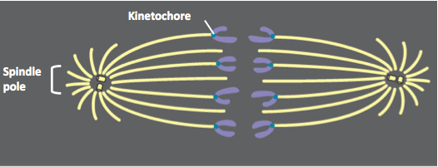
Spindle Fibres
Protein structures that guide chromosomes during cell division
Attach to chromosomes at the centromere
Pulling on centromere causes sister chromosome to separate to their respective poles

Slide 8
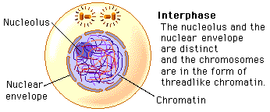
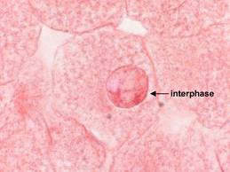
Interphase
Non-dividing phases
A cell spends around 90% of its time in interphase
The cell grows during interphase, but can only get so big before it is healthier to divide then continue to grow

Slide 9
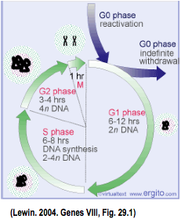
Interphase
During this stage cell takes in nutrients, grows, and other normal cell functions
3 phases of the cell cycle occur during interphase
  G1 phase
  S phase
  G2 phase

Slide 10
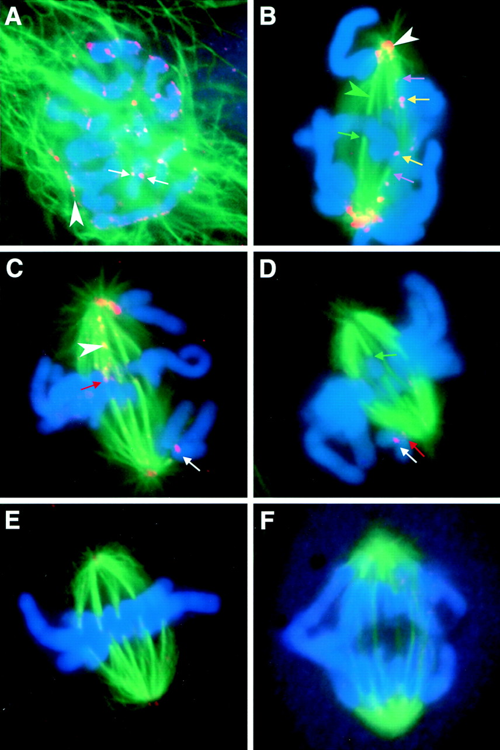
Mitotic Phase
M phase
Phase where the cell undergoes cell division
Name for process of cell division - Mitosis
During M phase the cell is entirely devoted to cell division

Slide 11
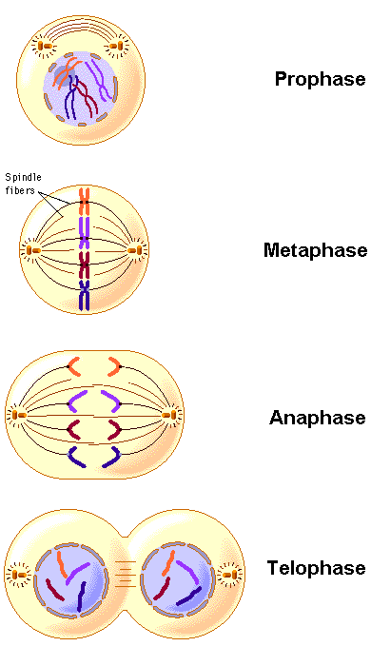
Mitosis
Contains 4 phases (PMAT):
  Prophase
  Metaphase
  Anaphase
  Telophase
In the final phase of mitosis
two daughter cells are formed
  Daughter cells have identical genetic information

Slide 12
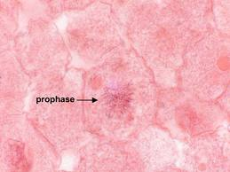
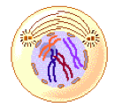
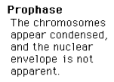
1. Prophase
First phase of mitosis
  Follows interphase
Often described as to steps, but are one single phase
  Early Prophase
  Late Prophase

Slide 13
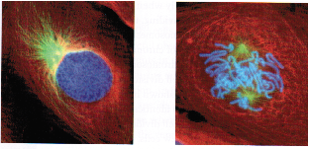
1. Prophase
Early Prophase
Chromatin condenses into chromosomes
  Chromosome made of sister chromatids, joined by centromere
Nuclear envelope begins to break down
Centrioles begin moving to poles of cell
Spindle fibres form
Late Prophase
Nuclear envelope broken down
Centrioles at the poles of the cell
Spindle fibres attach to chromosome at the centromeres

Slide 14
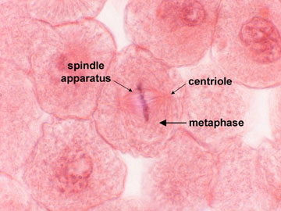
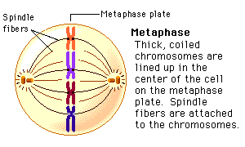
2. Metaphase
Chromosomes completely condensed
Chromosomes move to centre of cell
  Line up along the median, or cell equator
Mitotic Spindle complete
  Spindle fibres connected to a centriole and centromere of a chromosome

Slide 15
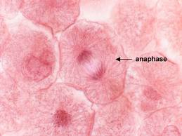
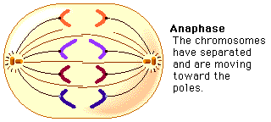
3. Anaphase
Sister chromatids separate at centromere
Each chromatid now a complete chromosome
Separated chromosomes now pulled to opposite ends of cell

Slide 16
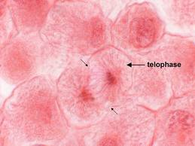
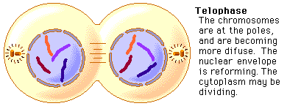
4. Telophase
Nuclei form at poles
Mitotic spindle disappears
Chromosomes start unpacking back to chromatin
Cell divides cytoplasm into two equal portions
  This process is known as cytokinesis

Slide 17
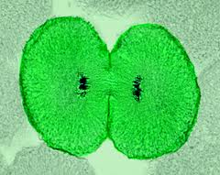
Cytokinesis
Animal cells cell membrane pinches to split new cells
Plant cells the cell plate form cell wall and inner cell membrane of new cells
After cytokinesis
daughter cells enter
interphase, G1 phase
and the cell cycle
repeats itself

Slide 18
Meiosis
Process by which sex cells, gametes, are formed (takes place in the ovaries and testes)
Involves two stages of cell division
  Stages are called Meiosis I and Meiosis II
  These stages of cell division have some similarities to the phases in mitosis

Slide 19
Meiosis
In meiosis the new cells (daughter cells) formed have half the number of chromosomes as the parent cell
  Example: Human somatic cells (normal cells) have 46 chromosomes, while human gametes only have 23 chromosomes

Slide 20
Meiosis
Gametes formed have the same number and type of chromosomes
Number of chromosomes in a gamete is called the haploid chromosome number, n
Number of chromosomes in other cells diploid number, double the haploid number, 2n
In humans n= 23 and 2n=46

Slide 21
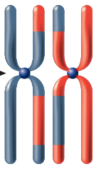
Meiosis I
Prophase I
Nuclear membrane begins to split and centriole splits and starts moving to poles
Chromosomes come together into their homologous pairs
Each chromosome of the pair is a
homologue and made of a pair of
sister chromatids
  Whole structure is then called a tetrad,
  as have 4 chromatids

Slide 22
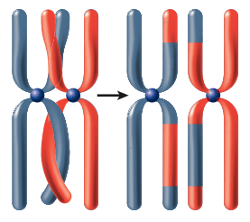
Meiosis I
Prophase I
The pairing of homologous chromosomes is called synapsis
As the chromosomes synapse, chromatid intertwine
Once intertwined chromatids
break and exchange segments
of genetic material
  Occurs between non-sister
  chromatids of the homologous
  pair
  This is called crossing over

Slide 23
Crossing Over
Event in which homologous chromosomes exchange genetic material between the paternal and maternal homologous chromosomes
Crossing Over
  Occurs every meiosis
  Site varies form meiosis to
  meiosis
  Can have many different
  outcomes
  Essential component for
  evolution as gives genetic
  variation

Slide 24
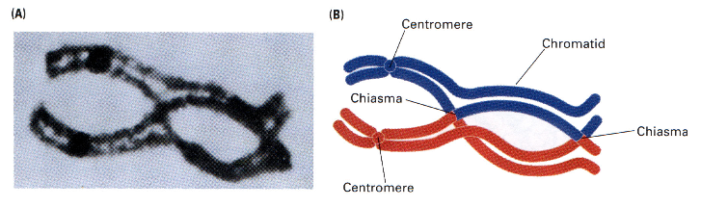
Crossing Over
Sites of crossing over are held by areas called chiasmata (these areas hold the non-sister chromatids together)

Slide 25
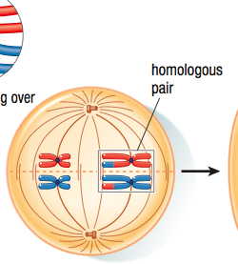
Meiosis I
Metaphase I
Homologous chromosomes:
  Attach to spindle fibres
  Line up along equatorial plate

Slide 26
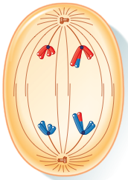
Meiosis I
Anaphase I
Homologous chromosomes move toward opposite poles
  Process is known as segregation
It is during this stage of meiosis I
that reduction division occurs
  One member of each homologous
  pair will be in each new cell
  Each chromosome is made of 2
  sister chromatids

Slide 27
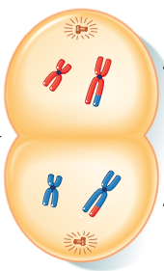
Meiosis I
Telophase I and Cytokinesis
Membrane begins to form around each nucleus
  Chromosomes in nuclei are not
  identical
  Daughter nuclei contain one
  member of each homologous
  chromosome
  Recall homologous pairs are similar,
  not identical
Cytokinesis divides the two cells
  Now ready for second stage of
  meiosis

Slide 28
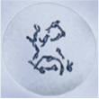
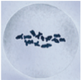
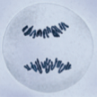
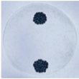
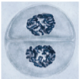
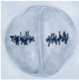
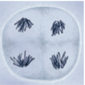
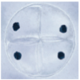
Meiosis II
Occurs at roughly same time in each of the haploid daughter cells made from meiosis I
No replication of chromosomes prior to entering meiosis II
Meiosis I
Meiosis II

Slide 29
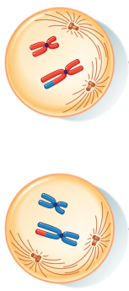
Meiosis II
Prophase II
Signals beginning of the second division
During prophase
  Nuclear membrane dissolves
  Centrioles move to poles and spindle fibres begin to form

Slide 30
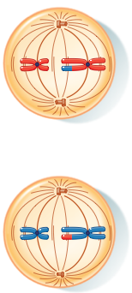
Meiosis II
Metaphase II
Chromosomes arrange along equatorial plate
  Recall each chromosome has 2 chromatids
Chromosomes attach to spindle fibres, but are still attached by centromeres

Slide 31
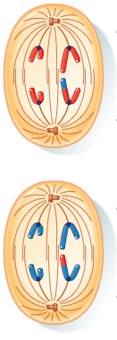
Meiosis II
Anaphase II
Chromosomes are broken into individual chromatids
  Centromere has split
Chromatids move towards opposite poles
Stage ends when nuclear memebrane begins to form around chromatids, now called chromosomes

Slide 32
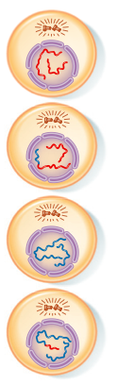
Meiosis II
Telopahse II and Cytokinesis
Nuclear membrane forms around chromosomes
This completes the second nuclear division
Cytokinesis
  Divides cytoplasm among daughter cells

Slide 33
Meiosis II
In the end finish with
  4 haploid daughter cells
  These cells can now become gametes

Slide 34
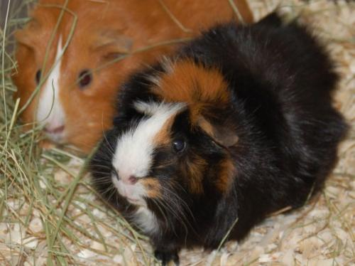
Punnett Squares
Example 2: In guinea pigs, the allele for black fur is dominant over the allele for brown fur. What would the F2 phenotype(s) be if a homozygous black fur guinea pig was crossed with a homozygous brown fur guinea pig? Start with the P1 generation and show both the F1 and the F2 Punnet Squares.
Notes:
Follow format on test for example

Slide 35
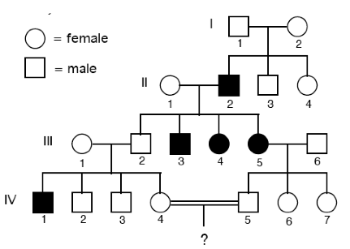
Pedigrees
A pedigree is a visual representation of how a trait is inherited in different generations
Pedigrees are used often in dog and horse breeding to track purebred animals.

Slide 36
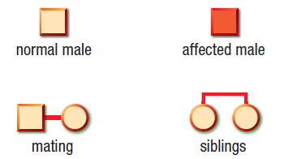
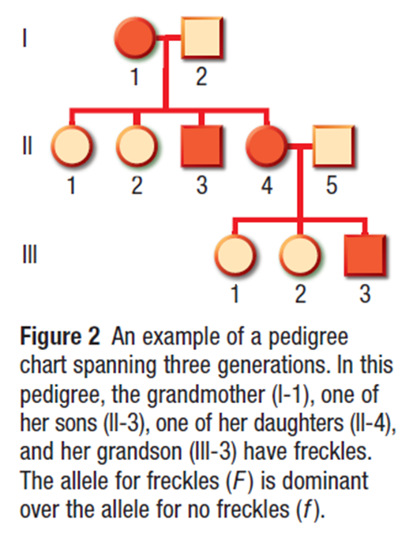
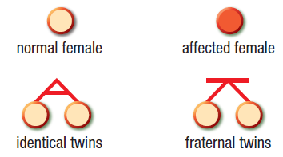
Pedigrees

Slide 37


Slide 38
For the rest of class…
Look at your review sheet, make sure you understand everything on it
Work on worksheets you have not yet finished (spongebob, monohybrid cross sheet, sex-linked traits sheet)
Work on the new worksheets (matching sheet, punnet square worksheet)
Please ask me questions if you need clarification on a topic!

