Slide 1
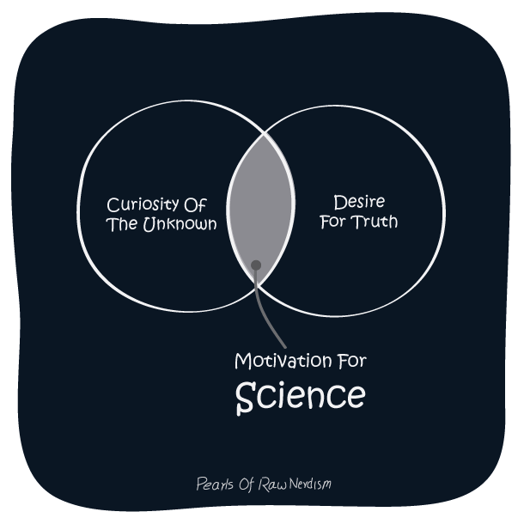

Slide 2
Unit 2: Biology
Big Ideas

Slide 3
Overall Big Ideas
Plants and animals, including humans, are made of specialized cells, tissues, and organs that are organized into systems.
Developments in medicine and medical technology can have social and ethical implications.

Slide 4
Overall Learning Goals
By the end of this unit I will be able to:
  Evaluate the importance of medical and technological developments related to organ systems, and analyse their societal and ethical implications
  Investigate cell division, cell specialization, organs, and systems in animals and plants, using research and inquiry skills, including various laboratory techniques
  Demonstrate an understanding of the hierarchical organization of cells, from tissues, to organs, to systems in animals and plants.

Slide 5
Chapter 2 (cells) Key Concepts
All organisms are made up of one of more cells
Microscopes enable us to examine cells in detail
The cell cycle occurs in distinct stages
Cell division is important for growth, repair, and reproduction
Cancer cells generally divide more rapidly than normal cells
Medical imaging technologies are important in diagnosing and treating disease
Notes:
These are in your text book!

Slide 6
Chapter 3 (Animal Systems) Key Concepts
Complex animals are made up of cells, tissues, organs, and organ systems
Scientists use laboratory techniques to explore the structures and functions within animals’ bodies
Each organ system has a specific function and corresponding specific structures
There are four main types of animal tissues
Organ systems interact to keep the organism functioning
Research is helping people overcome illness and injury

Slide 7
Chapter 4 (Plant Systems) Key Concepts
Plants have a shoot system and a root system
The organization of tissues, organs, and systems is different in plants to that in animals
Plants have dermal, vascular, and ground tissue systems
Scientists can change the genetic makeup of plants
Plant tissue systems interact to perform complex tasks
Meristems determine the pattern of growth

Slide 8
Note Taking and Text Questions
I want you to focus on what is being said, critically thinking about it, and asking questions
Once I am up and running on D2L I will be posting lectures
I also get a lot of my important information from the text book so reading the text is a good way to review class material
Sometimes I will assign text questions and I expect that they are done by everyone
If you would like to do any unassigned text questions, I will mark it to let you know how you are doing

