Slide 1
Genetic Disorders

Slide 2
Learning Goals
Use appropriate terminology related to genetics such as hemophilia and trisomy.
Describe some genetic disorders that are caused by chromosomal abnormalities (e.g.,non-disjunction) or other genetic mutations.

Slide 3
Case Study: Down Syndrome
What mutation has occurred to cause this disorder?
  Down Syndrome is also called trisomy 21
  They have an extra copy of chromosome 21

Slide 4
Case Study: Down Syndrome
How common is this disorder
  1 in 800 live births is a baby with Down Syndrome
  This is very common
Is this disorder caused by a mutation to autosomal chromosomes or sex chromosomes? Is it dominant or recessive?
  Down Syndrome is an autosomal disorder, it is found at chromosome 21
  It is neither dominant or recessive because there is a whole extra chromosome

Slide 5
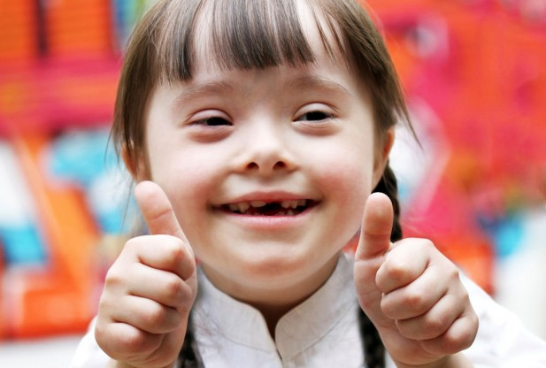
Case Study: Down Syndrome
Symptoms
  Excess genetic information and an unpaired chromosome in every cell
  Round, full face
  Short height
  Large forehead
  May cause developmental and social delays
Treatment
  Occupational and physical therapy
  Based on individual needs

Slide 6
Genetics Research Activity
With your home group, decide who will research the following diseases
  Turner Syndrome
  Tay-Sach’s Disease
  Klinefelter Syndrome
  Sickle Cell Anemia
If your group has 5 people in it, 2 people can research the same disease
Home groups:
  1: Kayla, Ethan, Jena, Mathew, Jahaziel
  2: Andrew, Mariah, Danny, Joe
  3: Sebastian, Nicole, Hunter Murray, Jen
  4. Kaitlyn, Jahnaya, Jacob, Meghan Mathieson
  5. Megan Slemmonds, Cole, Colton, Emily, Hunter Gebauer

Slide 7
Genetics Research Activity
Now move into your expert groups (everyone that is researching the same disease)
With your group, use all of your resources (text book, information sheet, chrome books) to fill out your organizer
Let me know if you have any questions, happy researching!

Slide 8
Genetics Research Activity
Move back to your home groups and tell the other members of the group about the disease you researched
If you are not presenting be sure to take notes there will be a section about disorders on your test
  You can take notes in point form or you can make yourself another organizer on a lined sheet of paper

Slide 9
Genetic Disorders
A genetic disorder is an illness caused by genetic changes to a person’s DNA
These changes can be:
  A change to a single gene that affects protein production
  An increase or decrease in the number of chromosomes
  Multiple changes to one or more genes combined with environmental factors
    Cancer
Notes:
Ask students what kind of change their disorder is (turner, klinefelter, tay-sachs, sickle cell)

Slide 10
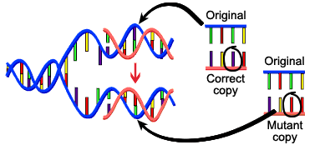
Genetic Disorders
A change in the normal DNA sequence is called a mutation
If the change is severe the baby may die while in utero or just after birth
Less severe mutations cause disorders than many people live with

Slide 11
Mutations on a Single Gene
Affects protein production
Can be recessive or dominant
  If it is dominant, they only need one allele to have the disorder
  If it is recessive, both of their alleles need to be the alleles for the disorder
  If someone has only one allele for a recessive disorder they do not exhibit symptoms but they are carriers of the allele for the disorder

Slide 12
Mutations on a Single Gene
Cystic Fibrosis
  Recessive
  1 in 3600 Canadians affected
  Mutation on chromosome 7
Galactosemia
  Recessive
  1 in 60 000 Canadians affected
  Mutation on chromosome 9
Neurofibromatosis Type 1
  Dominant
  1 in 3000-4000 Canadian affected
  Mutation on chromosome 17
Notes:
Mutation on chromosome 7 that affects the production of a protein that helps move salt into and out of cells
Mutation on chromosome 9 that affects production of an enzyme that breaks down galactose, a sugar in dairy products
Mutation on chromosome 17 that affects protein production that controls cell division

