Slide 1
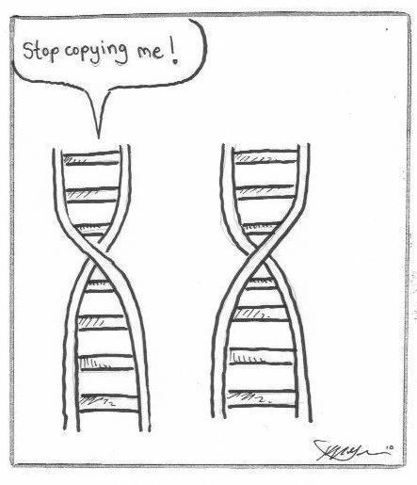

Slide 2
Cell Division
2.3/2.4

Slide 3
Learning Goals
By the end of this lesson I will be able to:
  Describe the cell cycle in plants and animals, and explain the importance of mitosis for the growth of cells and repair of tissues
  Explain what limits cell size

Slide 4
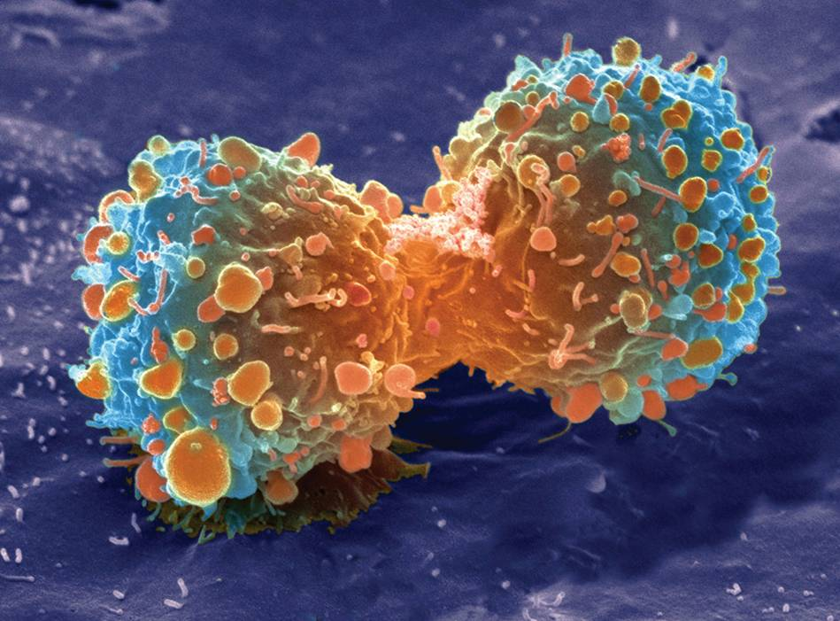
The Importance of Cell Division
You started as a single cell and now you are made up of trillions of cells!
This is due to cell division
Cell division allows organisms to reproduce, grow, and repair damage

Slide 5
Cell Division for Reproduction
All cells use cell division to reproduce
When a cell divides it is called the parent cell and the new cell is called the daughter cell
  The daughter cell has the same genetic information as the parent cell
When a single-celled organism reproduces, it reproduces asexually
  Only one parent involved
  Cell divides to create whole new organism that is genetically identical to the parent

Slide 6
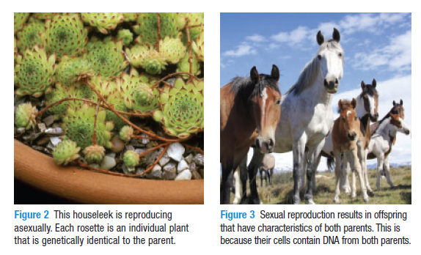
Cell Division for Reproduction
Multicellular organisms can reproduce either sexually or asexually
Asexual reproduction results in genetically identical offspring to one parent
Sexual reproduction involves two parents and offspring will have characteristics from each

Slide 7
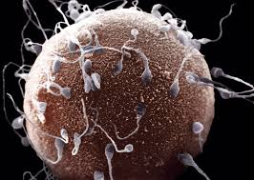
Cell Division for Reproduction
During sexual reproduction each parent gives a cell
These cells are not like normal body cells though, they only have half the number of chromosomes
  Sex cells divide further through meiosis to become haploid
We call these sex cells gametes

Slide 8
Cell Division for Growth
As a multicellular organism grows, the number of cells increases
  Think about it: why can’t the cell just grow bigger until it is the size of an adult human?
Plants and animals both been energy, nutrients, water, and gases
They also need to get rid of waste like carbon dioxide
Nutrients and chemicals enter and exit the cell across the cell membrane using diffusion
Water moves in and out by osmosis

Slide 9
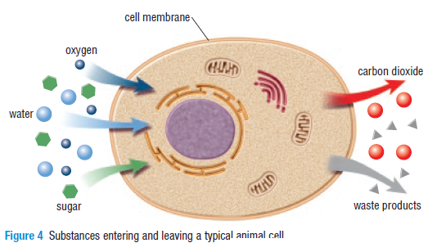
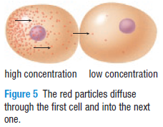
Cell Division for growth
During diffusion, chemicals move from and area of high concentration, to an area of low concentration
Osmosis works the same way, water moves from where there is lots of water, to where there is less water

Slide 10
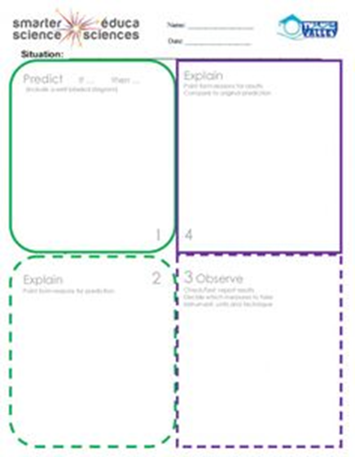
PEOE TIME!

Slide 11
Cell Division for Repair
Cells die all the time, you shed millions of dead skin cells every day
Cell division is important to make new cells to replace the dead cells
When you break a bone, or cut your knee, new cells are needed to heal
An organism could not living without cell division!

