Slide 1
Inheritance and punnett squares

Slide 2
Quick Quiz
What is a genotype? What is a phenotype?
How do we represent a homozygous dominant genotype?
How do we represent a homozygous recessive genotype?
What genotype would be represented by Rr?

Slide 3
Learning Goals
Understand what a genetic cross is and why we use them
Be able to solve basic problems in genetics that involve monohybrid crosses, using the Punnett square method
Be able to trace inheritance through generations using pedigrees

Slide 4
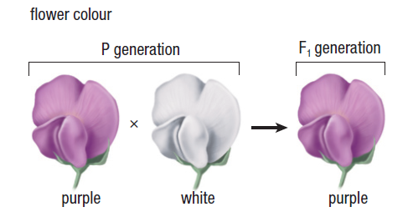
Genetic Crosses
Genetic Cross: any type of deliberate breeding between a male and a female to produce offspring that carry the genetic material of each parent
  This is what Mendel did in his experiments
Monohybrid Cross: A genetic cross between parents that differ by only one trait, which is the trait being studied

Slide 5
Punnett Squares
Notes:
Some punnett square you may see might only have 4 boxes, if this is the case just write the letters outside the box.

Slide 6
Punnett Squares
Step 1: Write down the genotypes of the two individuals being crossed (the mother and father)
Step 2: Fill in the genotypes of the offspring on the Punnett Square
Step 3: Calculate the percentage of offspring that have each genotype
Step 4: Calculate the percentage of offspring that have each phenotype
Step 5: Write a statement that summarizes your results

Slide 7
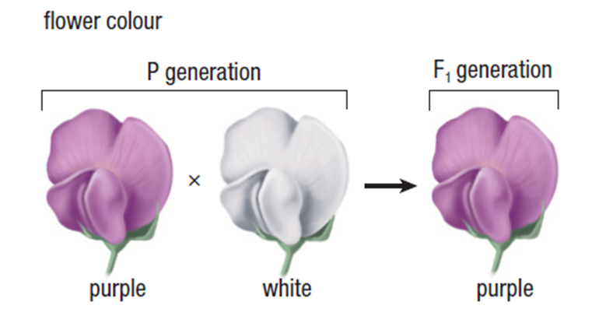
Punnett Squares
Example 1: In pea plants, purple flower is dominant to white flower. A homozygous recessive plant (pp) is crossed with a heterozygous plant (Pp). Give the genotypes and the phenotypes of the expected offspring.
Notes:
Follow format on test for example

Slide 8
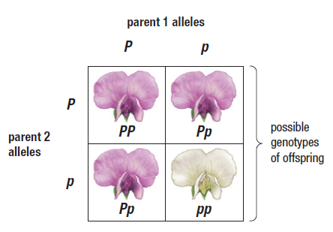
Punnett Squares
Example 1: In pea plants, purple flower is dominant to white flower. A homozygous recessive plant (pp) is crossed with a heterozygous plant (Pp). Give the genotypes and the phenotype the expected offspring.

Slide 9
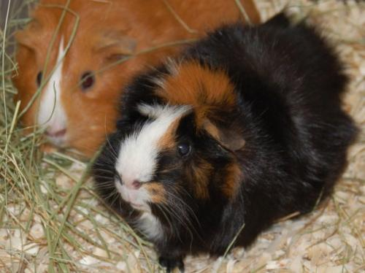
Punnett Squares
Example 2: In guinea pigs, the allele for black fur is dominant over the allele for brown fur. What would the F2 phenotype(s) be if a homozygous black fur guinea pig was crossed with a homozygous brown fur guinea pig? Start with the P1 generation and show both the F1 and the F2 Punnet Squares.
Notes:
Follow format on test for example

Slide 10
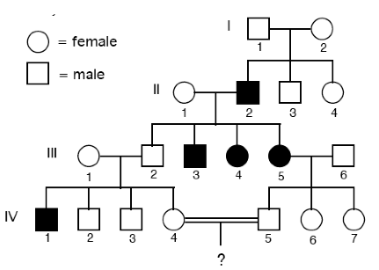
Pedigrees
A pedigree is a visual representation of how a trait is inherited in different generations
Pedigrees are used often in dog and horse breeding to track purebred animals.

Slide 11
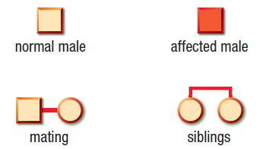
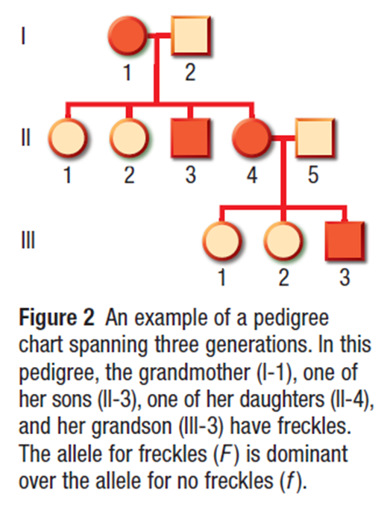
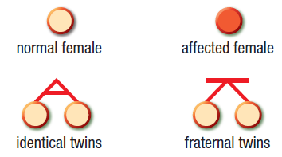
Pedigrees

Slide 12
Virtual Fly Lab
With a partner, get a chrome book and go to www.unc.edu/~abcook18/VirtualFly1.html
  We have 13 chrome books so some people will not have to pair up. No groups of three please!
Once finished please return the chrome book to the box.

