Slide 1
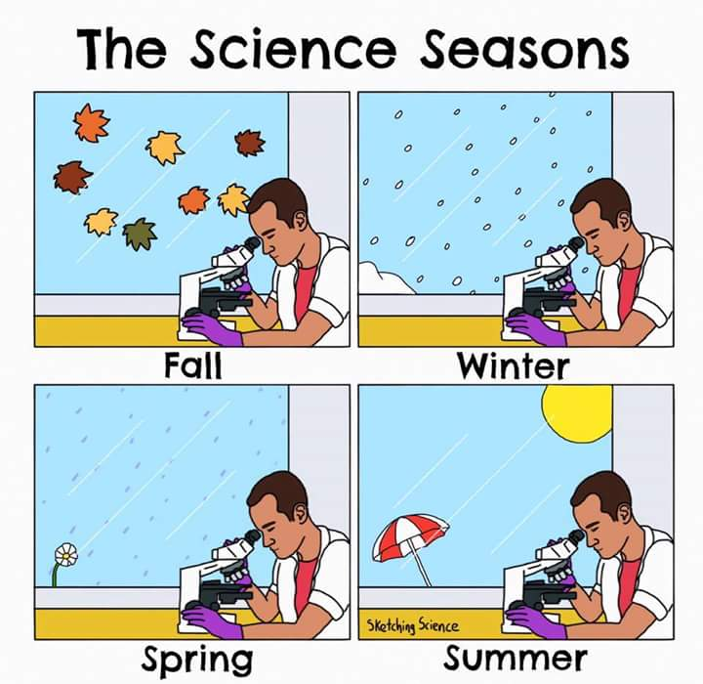

Slide 2
The Respiratory System
3.6

Slide 3
Learning Goals
By the end of this lesson I will be able to…
  Describe the primary functions of the circulatory system
  Name all of the organs in the circulatory system and state their function
  Describe various diseases of the circulatory system

Slide 4
The Respiratory System
When I say go, breathe like you normally do but count your breaths (in and out = 1 together)
  How many times did you breathe in a minute?
Your rate of breathing increases or decreases based on exercise
On average a person will move more than 10 000L of air in a day (with normal breathing)
Notes:
Avg breaths/min is 15

Slide 5
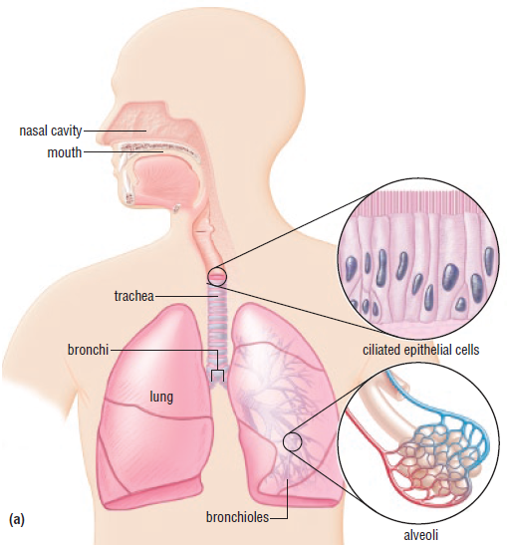
The Respiratory System
Main function: providing oxygen to the body and removing carbon dioxide
Works very closely with the circulatory system

Slide 6
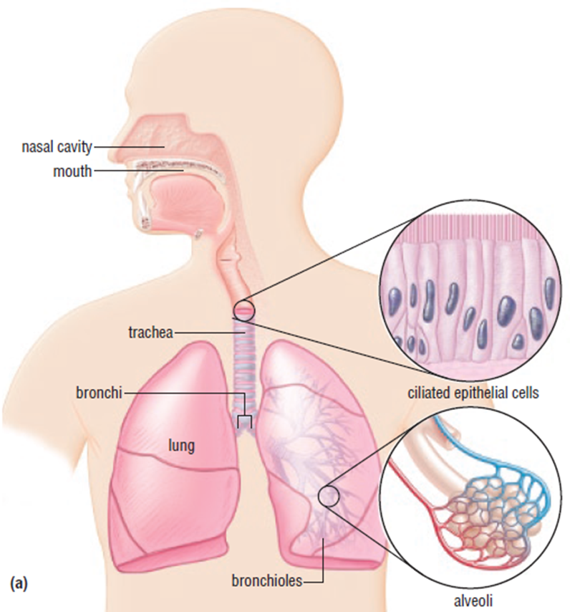
The Respiratory system: Structures
Consists of the lungs and the other organs that connect the lungs to the outside of the body
Air enters first through the mouth and nose, then down the pharynx (throat), and down the trachea (windpipe)

Slide 7
The Respiratory system: Structures
After air goes down the trachea, it splits off into two bronchi and the bronchi deliver the air to the lungs
Epithelial cells line the trachea and bronchi and produce mucus

Slide 8
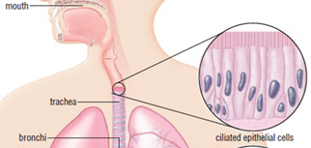
The Respiratory System: Structures
The epithelial cells also have cilia (hair-like projections)that help move mucus and filter out foreign material

Slide 9
The respiratory System: Structures
The trachea is supported by rings of cartilage
  Feel your trachea through the skin on your neck, can you feel them?
Cartilage is connective tissue that is made of a network of cells and fibres but is not living material
A flap called the epiglottis makes sure that food does not get into the trachea, but instead is directed to the esophagus
  Sometimes food can get past the epiglottis, choking on food or water is your body’s way of getting the food and water out of where it is not supposed to be

Slide 10
Gas Exchange
This is the main purpose of the respiratory system
Oxygen diffuses into the bloodstream in the lungs, and carbon dioxide diffuses out in the same way
We need oxygen all the time so the respiratory system must be very efficient at doing this!

Slide 11
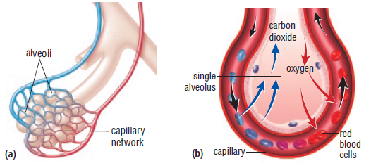
Gas Exchange
Each of the bronchi branch many times, ending in tiny air sacs called alveoli
Alveoli have very thin walls and are surrounded by capillaries
Oxygen and Carbon dioxide have to diffuse through the wall of the alveoli and the wall of the capillary to get to the bloodstream

Slide 12
Gas Exchange
The circulatory system must supply lots of blood to the lungs to make them more efficient
The concentration of oxygen in the blood that goes through the lungs is less than the concentration of oxygen in the alveoli
  This causes the oxygen to diffuse into the blood (remember how diffusion works! Low concentration → high concentration)
The concentration of carbon dioxide is greater in the blood so it diffuses into the alveoli to be exhaled by the lungs

Slide 13
BReathing
Drawing air into the lungs (inhaling) and pushing air out of the lungs (exhaling)
The diaphragm (a muscle under the lungs) and more muscles around the lungs work to increase the volume of the lungs by pushing the rib cage up
The change in volume results in a change in pressure in the lungs, which causes the inhale or exhale
Breathe deeply a couple of times, what happens to your chest when you exhale? What happens when you inhale?

Slide 14
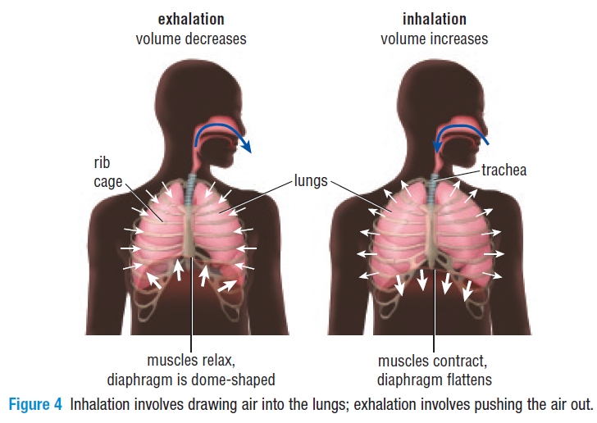
BReathing

Slide 15
Control of Breathing
The control of our breathing is involuntary which means it is not in our conscious control!
  We don’t have to think about breathing
How long can you hold your breath?
Breathing rate depends on how much carbon dioxide is in the blood, if the brain senses a high concentration of carbon dioxide, it sends a message to your muscles to increase your breathing rate

Slide 16
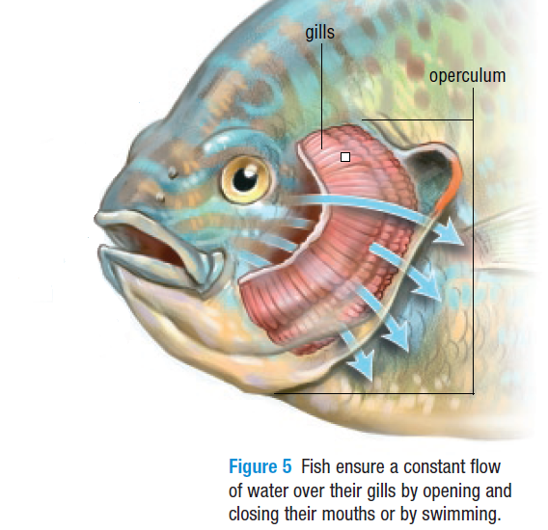
Respiratory System in Fish
Gas exchange occurs in the gills, they don’t have lungs
Gills also have many capillaries that bring blood close to the water so oxygen can diffuse in from the water and carbon dioxide can diffuse out

Slide 17
Respiratory System in Fish
Fish don’t breathe like humans do but they open and close their mouths to move water over their gills
Some fish need to swim constantly to get enough water over their gills

Slide 18
Activity
I am going to number you off into groups of 6
With your groups you are going to research one of the following respiratory diseases and tell the class about it
  SARS
  Tuberculosis
  Asthma
  Lung Cancer
  Cystic Fibrosis
You need to include:
  What it is
  Signs and symptoms
  Treatment
  Facts about the disease
You will also create a short word doc about the disease for me to post on D2L

