Slide 1
Ventilation and Breathing

Slide 2
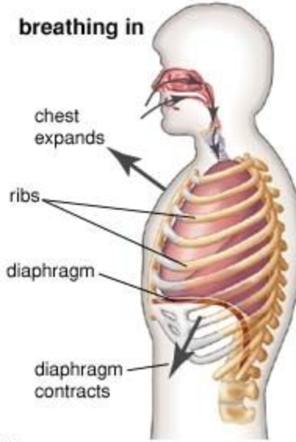
The Mechanism of Ventilation
Based on the principle of negative pressure
Pressure inside the lungs becomes lower than atmospheric pressure so air is forced into the lungs
  Air moves from high pressure to low pressure (similar to diffusion!)
During Inhalation
  Brain tells diaphragm to contract (flattens diaphragm)
  External intercostal muscles (between ribs) contract and pull ribs out and up
    This increases thoracic cavity volume and reduces pressure in lungs
  Since the pressure is now lower in the lungs, air rushes in to equalize the pressure

Slide 3
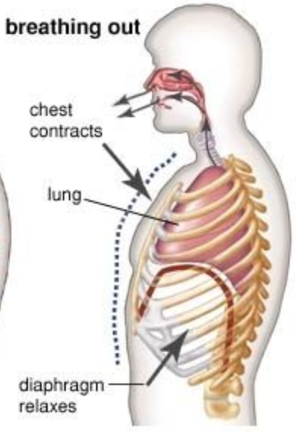
The Mechanism of Ventilation
During Exhalation
  Diaphragm relaxes into normal upwards dome shape which pushes up on lungs
  External intercostal muscle relax and ribs fall
  Pressure in the lungs is greater than atmospheric pressure so air is forced out
During strenuous exercise or force exhalation, the internal intercostal muscles are engaged
Pleural Membranes: thin layer of connective tissue that covers the outer surface of the lungs and lines the thoracic cavity; holds fluid in the pleural cavity to reduce friction during breathing

Slide 4
Lung Capacity
Total lung volume depends on sex, body type, and lifestyle
Total lung capacity: maximum volume of air that can be inhaled during a single breath – we usually are not using our total lung capacity
Tidal volume: volume of air inhaled or exhaled during a normal involuntary breath. (About 0.5 L in the average adult)
Inspiratory reserve volume: volume of air that can be forcible inhaled after a normal inhalation
Expiratory reserve volume: volume of air that can be forcibly exhaled after a normal exhalation
Residual volume: volume of air remaining in the lungs after forced exhalation
Vital capacity: maximum amount of air that can be inhaled or exhaled; 4.4-4.8L in males, 3.4-3.8L in females

Slide 5
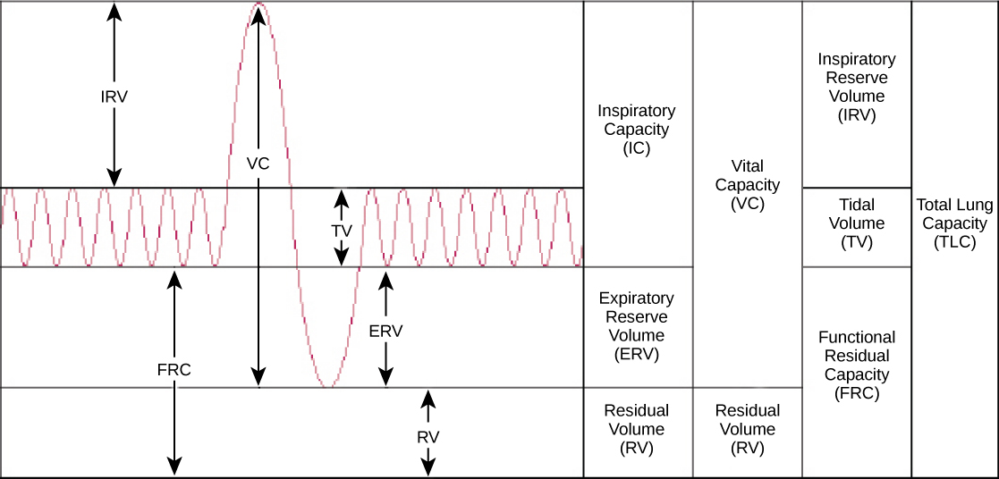

Slide 6
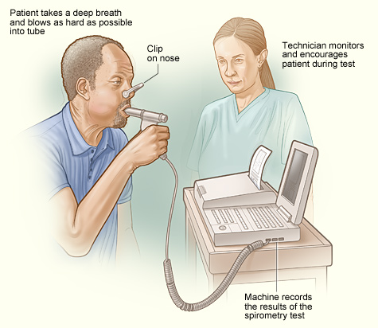
Oxygen Useage
VO₂: an estimated or measured value representing the rate at which oxygen is used in the body (measure in mL/kg/min)
VO₂max: maximum rate at which oxygen can be used in an individual (measured in mL/kg/min)
We can calculate these using a spirometer

Slide 7
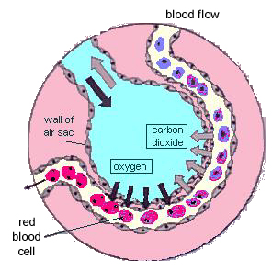
Partial Pressures
The air we breathe is made up of a mix of gases (20.9% O₂ and 0.0391% CO₂)
Total air pressure = sum of all the partial pressures
  Ex. Air pressure at sea level = 101.3 kPa, so the partial pressure of oxygen at sea level is 20.9% of 101.3kPa = 21.17 kPa = P_{O2}
Partial pressures influence gas exchange, gases diffuse from areas of high pressure to areas of low pressure until the pressure is equal

Slide 8
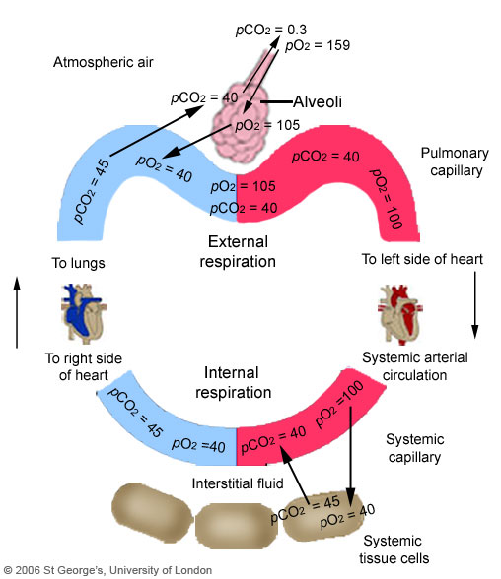
Oxygen Transport and Diffusion
O₂ moves from alveoli (where P_{O2} is higher; ~13.3 kPa) to bloodstream (where P_{O2} is lower; ~5.33 kPa)
The circ. system transports oxygen attached to hemoglobin as well as some dissolved in blood plasma
Hemoglobin is an iron-containing protein that increases oxygen carrying capacity of blood by 70 times.
Deoxygenated blood P_{O2} = ~5.33 kPa
Oxygenated blood P_{O2} = ~13.3 kPa

Slide 9
O₂ Transport
In red blood cell – haemoglobin (a protein which carries the O₂)
Haemoglobin + O₂ ←→ oxyhaemoglobin
Direction depends on the oxygen concentration in surrounding tissues
i.e. if high – O₂ stays bound to haemoglobin
if low – O₂ is released to surrounding tissue

Slide 10
Carbon Dioxide Transport and Diffusion
Produced in cells through aerobic cellular respiration
P_{CO2} of tissue fluid = ~5.60 kPa
P_{CO2} in capillaries = ~5.33 kPa
Transported in blood three ways
  7% dissolved in plasma
  20% attaches to hemoglobin
  73% reacts with water to form carbonic acid

Slide 11
CO₂ Transport
Diffuses from cells into red blood cells
Transported in 3 ways:
1) carried as dissolved gas molecules in the water of the blood (very small amount)
2) combines with haemoglobin (small amount)
3) reacts with water to produce bicarbonate ions (HCO₃⁻) which diffuse out into liquid part of blood and transported to lungs
CO₂ + H₂O ←→ H₂CO₃ → HCO₃⁻ + H⁺
carbonic acid bicarbonate ion hydrogen ion

